Slide 1

Premier League Player Performance Analysis
End-to-end analytics pipeline: Python · MySQL · Power BI
2023-24 SEASON
SPORTS ANALYTICS

Slide 2

Project Mission
The Challenge
The Solution
Transform raw Kaggle football data into actionable insights through professional data engineering
Complete analytics workflow: data cleaning, database modeling, interactive visualization

Slide 3




Data Pipeline Architecture
Raw Data
Python Processing
Kaggle CSV with player stats, nationality codes, positions
Pandas cleaning, standardization, country mapping
MySQL Transform
Power BI
Normalization, joins, ETL best practices
Interactive dashboards, custom themes

Slide 4

Python: Data Cleaning & Transformation
Data Import
Standardization
Loaded raw CSV with Pandas, assessed data quality and structure
Cleaned column names, converted nationality codes to full country names
Formatting
Export
Reordered columns, optimized data types for analytics readiness
Generated clean Excel output for downstream processing

Slide 5

MySQL: Database Engineering
Professional ETL Practices
Created normalized mapping tables for country codes
Implemented SQL joins for data integration
Built analytics-ready dimensional model
Applied database design best practices
Result: Clean, queryable dataset optimized for BI tools

Slide 6
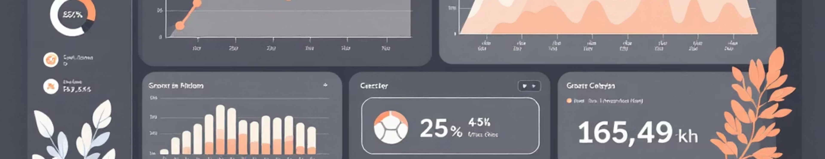
Power BI Dashboard: Key Metrics
500+
20
4
Players Analyzed
Premier League Teams
Core Dimensions
Complete 2023-24 season roster data
Full league coverage and insights
Position, nationality, age, playing time

Slide 7
Dashboard Insights Delivered
Player Utilization
Positional Analysis
Age vs Playing Time
Nationality Distribution
Minutes played, starts, and match participation patterns
Performance metrics by position: forwards, midfielders, defenders
Career stage trends and experience correlation
Global talent composition and contribution analysis

Slide 8




Technical Skills Demonstrated
Python
MySQL
Pandas, data wrangling, ETL automation
Joins, normalization, query optimization
Power BI
DAX, custom themes, interactive dashboards

Slide 9

Why This Project Matters
Real-world workflow
Mirrors industry data engineering practices from ingestion to visualization
Multi-tool proficiency
Demonstrates seamless integration across analytics stack
Portfolio-ready output
Professional dashboards showcasing technical and design skills

Slide 10


Key Takeaways
End-to-End Expertise
Data Quality Focus
Actionable Analytics
From raw data extraction to polished business intelligence
Professional cleaning, transformation, and validation at every stage
Interactive dashboards that drive decision-making and insight discovery

Slide 11
